Slide 1
Decision Structures
- By
Hemlata Kohin

Slide 2
Today’s Objectives
To get practice using the Boolean data type
To understand how to use decision structures
–One-way (using if)
–Two-way (using if and else)
–Multi-way (using if, elif, and else)
To learn about nested decision structures

Slide 3
Quick Introduction to main()

Slide 4
main()
In today’s class, we introduce the code
def main():
as the first line of code in our file
main() is an example of a function
We can use functions to organize our code
–We’ll cover them in detail later

Slide 5
Functions
For now, think of functions as something similar to a variable
–Variables hold data
–Functions hold code
We use the variable’s name to access its data
We use the function’s name to access its code

Slide 6
Using main() for Your Code
From now on, use main() in your code
–Every file should have main()
def main():
className = input("What class is this? ")
print(className, "is awesome!")
main()
Declaring main function
Calling our main() function

Slide 7
Control Structures
Structures that control how the program “flows” or operates, and in what order
Sequence
Decision Making (Covering today)
Loops (will be covering later)

Slide 8
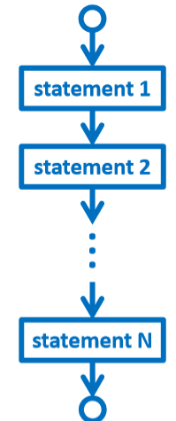
Sequence
One step after another, with no choices to make
What are some real life examples?
–Dialing a phone number
–Purchasing and paying for groceries

Slide 9
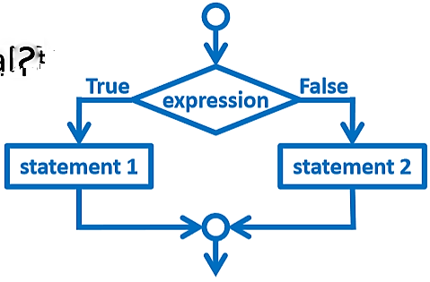

Decision Making
Selecting one choice from many based on a specific reason or condition
–If something is true, do A… if it’s not, do B
Some real life examples?
–What homework to work on tonight
–Choosing where to eat lunch

Slide 10
One-Way Decision Structures
Decision structures let Python make choices
–Based on some condition
def main():
weight = float(input("How heavy is your bag? "))
if weight > 50:
print("That bag is too heavy.")
print("There will be a $25 charge.")
print("Thank you for your business.")
Main()

Slide 11
“if” Statements
The Python if statement is used to implement the decision
if <condition>:
<body>
The condition must evaluate to True or False
The body is a sequence of one or more statements indented under the if heading

Slide 12
Formatting Decision Structures
Each if statement must close with a colon
–Two vertical dots (:)
Code in the body(that is executed as part of the if statement) must be indented
–By four spaces
–Hitting the “Tab or enter” key in many editors will automatically indent it by
four spaces

Slide 13
“if” Semantics
• The semantics of the if should be clear
–First, the condition in the heading is evaluated
–If the condition is True
• The statements in the body are executed • Control passes to the next statement in the program
–If the condition is False
• The statements in the body are skipped
• Control passes to the next statement in the program

Slide 14
One-Way Example: Temperature
You’re studying abroad, and need to convert the temperature from Celsius to Fahrenheit
def main():
celsius = float(input("What is temp in Celsius? "))
fahrenheit = 9/5 * celsius + 32
print("The temperature is", fahrenheit, "degrees Fahrenheit.") main()

Slide 15
Temperature Warnings
• Let’s now modify the program to print a warning when the weather is extreme
• Any temperature that is…
–Over 95 degrees Fahrenheit
• Will cause a hot weather warning
–Lower than 32 degrees Fahrenheit
• Will cause a cold weather warning

Slide 16
Temperature Example Code
def main():
celsius = float(input("What is temp in Celsius? "))
fahrenheit = 9 / 5 * celsius + 32
print("The temperature is", fahrenheit, "degrees Fahrenheit.")
if fahrenheit > 95:
print("It's really hot out there, be careful!")
if fahrenheit < 32:
print("Brrrrr. Be sure to dress warmly!")
main()

Slide 17
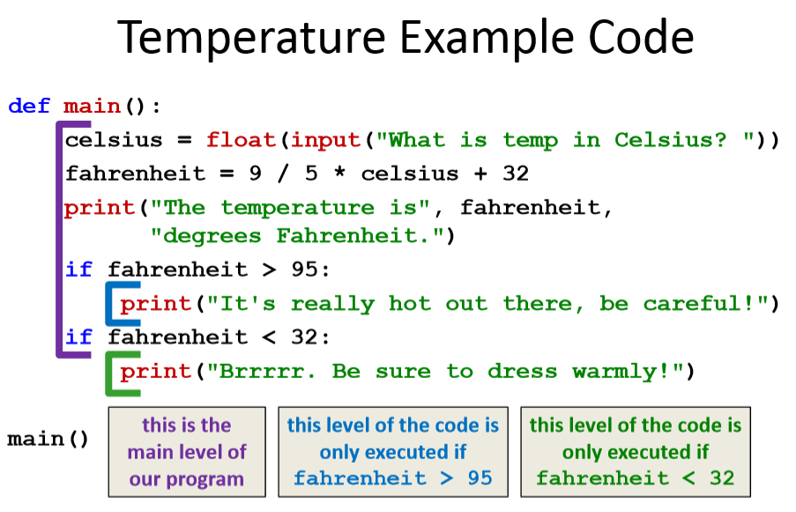

Slide 18
Two-Way Decision Structures

Slide 19
Two-Way Decisions
In Python, a two-way decision can be used by adding an else clause onto an if clause
This is called an if-else decision structure:
if <condition>:
<codeA statements> else:
<codeB statements>

Slide 20
How Python Handles if-else
Python will evaluate the condition, and then…
–If the condition is True, the set of codeA statements under the if are executed
–If the condition is False, the set of codeB statements under the else are executed
The code that comes after the if-else is executed only after one of the sets of statements is executed

Slide 21
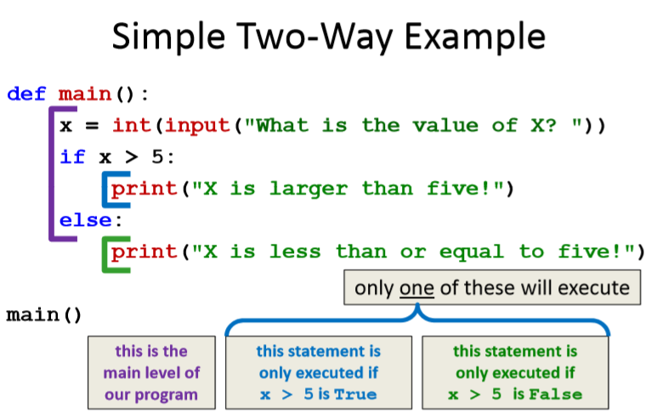
If-else Example

Slide 22
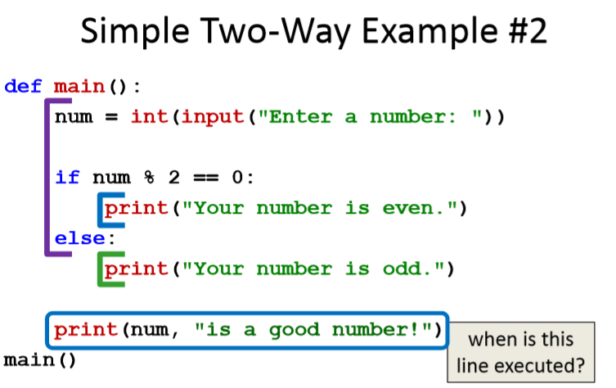

Slide 23
Multi-Way Decision Structures

Slide 24
“elif” Statements
The Python elif statement is used to handle additional exclusive conditions
–Must have a “starting” if statement
–The elif statements must have a condition
if <condition1>:
<codeA statements>
elif <condition2>:
<codeB statements>
Short for ‘else if’

Slide 25
Multi-Way Code Framework
if <condition1>:
<codeA statements>
elif <condition2>:
<codeB statements>
elif <condition3>:
<codeC statements>
# more "elif" statements if needed
else:
<codeD statements>
As many “elif” cases as are needed
Else statement is optional

Slide 26
Multi-Way Decision Example
A computer science professor gives a five-point quiz at the beginning of every class
Possible grades are as follows:
5 points: A 3 points: C 1 point: F
4 points: B 2 points: D 0 points: F
To print out the letter grade based on the raw points, what would the code need to look like?

Slide 27
Multi-Way Decision Solution
def main():
score = int(input("Your quiz score out of 5: "))
if score == 5:
print("You earned an A")
elif score == 4:
print("You earned a B")
elif score == 3:
print("You earned a C")
elif score == 2:
print("You earned a D")
else:
print("You failed the quiz")
Main()

Slide 28
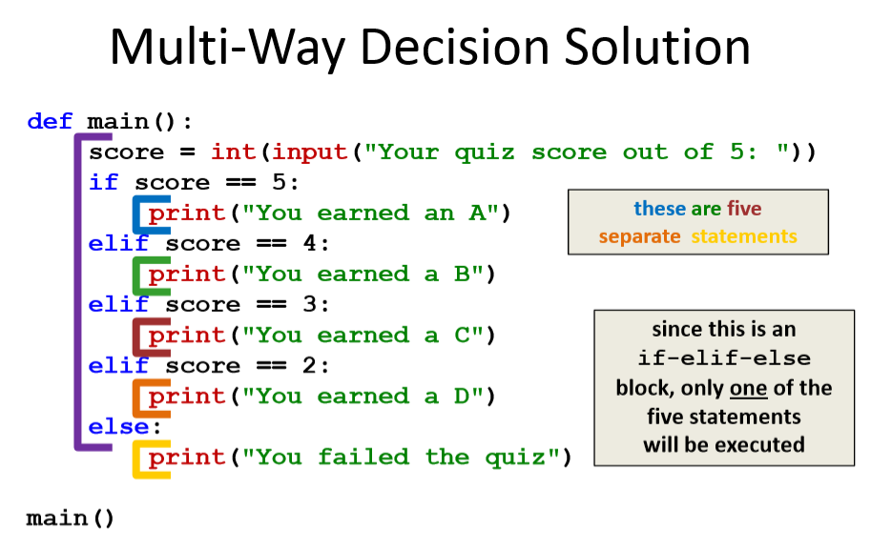

Slide 29
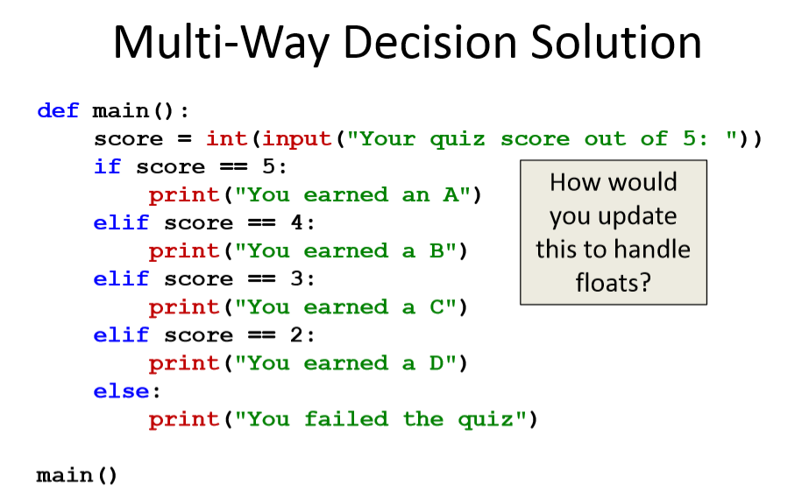

Slide 30
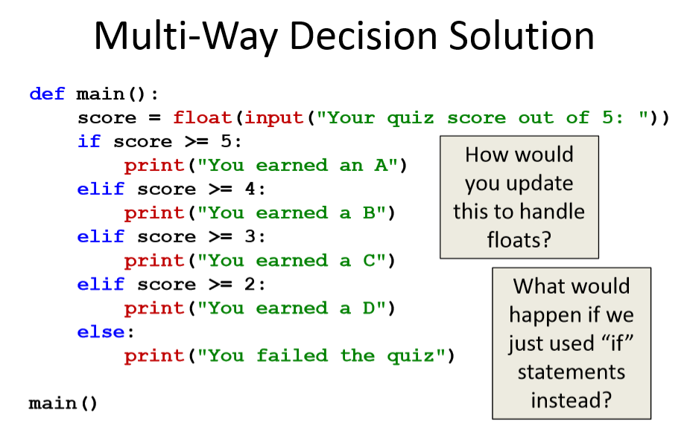

Slide 31
Nested Decision Structures

Slide 32
Nested Decision Structures
Python allows you to nest decision structures –As many levels deep as you want
–Nesting can occur inside if,
elif, or else statements
Only “rule” is that every inside level must start with an “if”
–Having matching elifs or an else is not required

Slide 33
Nested Decision Structure Example
• For example, we may
– Ask the user if they have a pet
–if they have a pet
• Ask the user what type of pet
• if they have a dog, take it for a walk
• elif they have a cat, clean the litter box
• else clean the cage/stable/tank

Slide 34
Nested Decision Structure Example
def main():
ans = input("Do you have a pet? (yes/no) ")
if ans != "no":
pet = input("What kind of pet do you have? ")
if pet == "dog":
print("Take it for a walk")
elif pet == "cat":
print("Clean the litter box")
else:
print("Clean the cage/stable/tank")
main()

Slide 35
Nested Decision Structures Code
if <condition1>:
if <condition2>:
<codeA statements>
elif <condition3>:
<codeB statements>
else:
<codeC statements>
else:
<codeD>

Slide 36
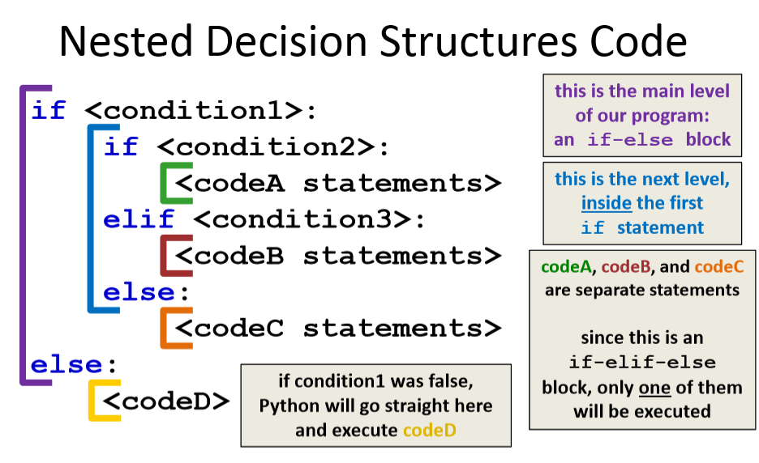

Slide 37
Nested Decision Structure Example
You recently took a part-time job to help pay for your student loans at a local cell phone store
If you sell at least $1000 worth of phones in a pay period, you get a bonus
–Your bonus is 3% if you sold at least 3 iPhones, otherwise you
bonus is only 2%

Slide 38
Nested Decision Solution
def main():
totalSales = float(input("Please enter your total sales:"))
if totalSales >= 1000.00:
# only ask this if they are eligible for a bonus
iPhonesSold = int(input("Enter the number of iPhones sold:"))
if iPhonesSold >= 3:
bonus = totalSales * 0.03
else:
bonus = totalSales * 0.02
print("Your bonus is $", bonus)
else:
print("Sorry, you do not get a bonus this pay period.")
main()

Slide 39
Nested Decision Structure Example
Use the input keyword to take a numerical value from the user and find out whether it is negative, positive or zero.
Type a Python program to find the largest number among the three input numbers

Slide 40
Link
https://www.programiz.com/python-programming/examples/positive-negative-zero
https://www.programiz.com/python-programming/examples/largest-number-three

Slide 41
Any Questions?

